Slide 1

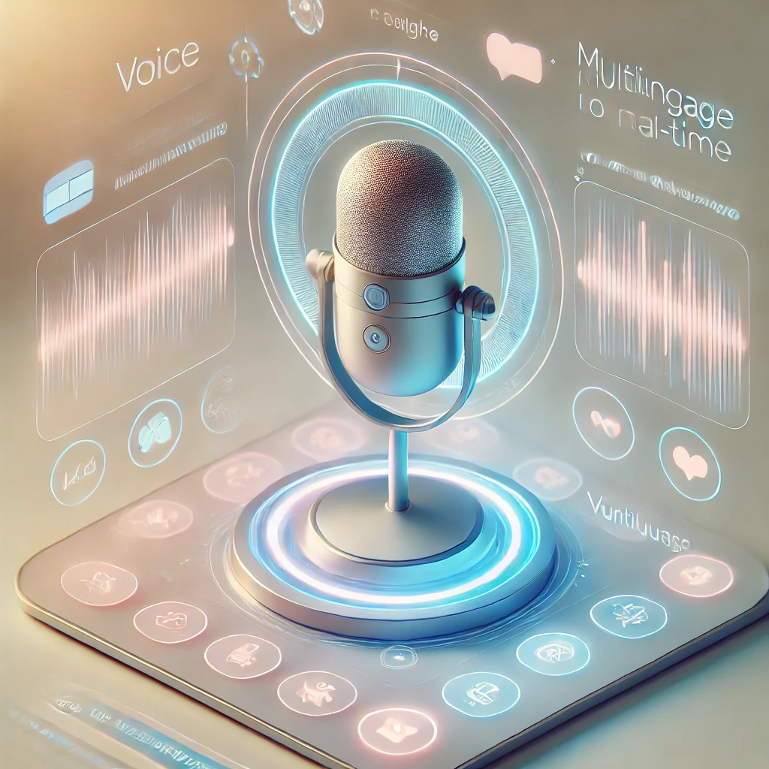

BEYOND_QWERTY
PROJECT
Voice Enabled Form Filling Project
-By Infosys Interns

Slide 2
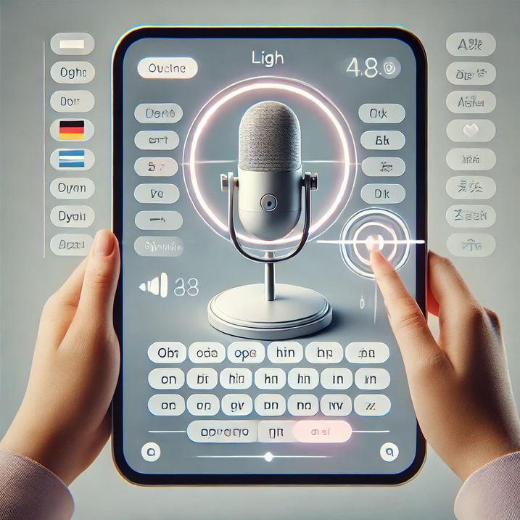
INTRODUCTION
"Beyond QWERTY" is an AI-powered, voice-enabled form-filling system.
It utilizes speech recognition to allow users to fill forms effortlessly.
Reduces typing effort and eliminates manual data entry challenges.
Breaks language barriers, improving inclusivity in digital interactions.

Slide 3

PROBLEMS
Traditional form filling is time-consuming and error-prone.
Typing difficulties for non-tech users, elderly individuals, and differently-abled people.
Language barriers make it hard for vernacular users to fill forms.
Need for a voice-enabled, AI-powered solution to simplify the process.

Slide 4
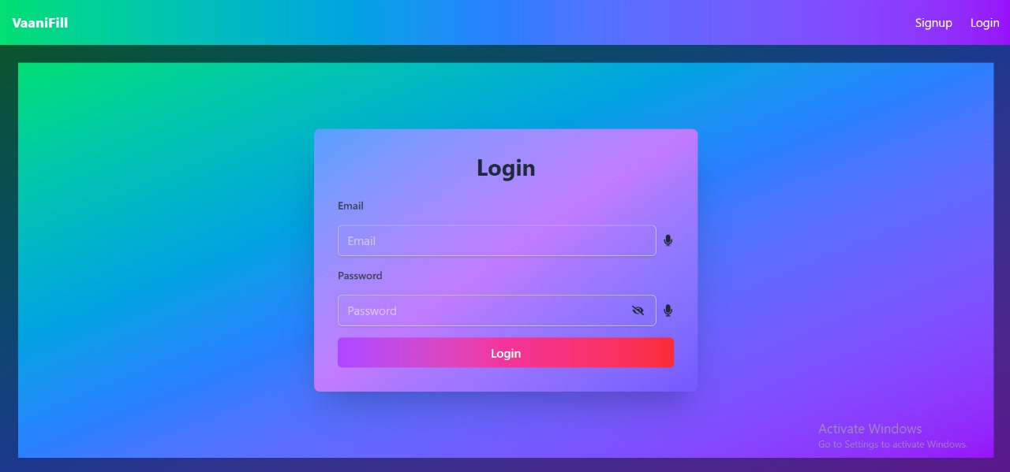
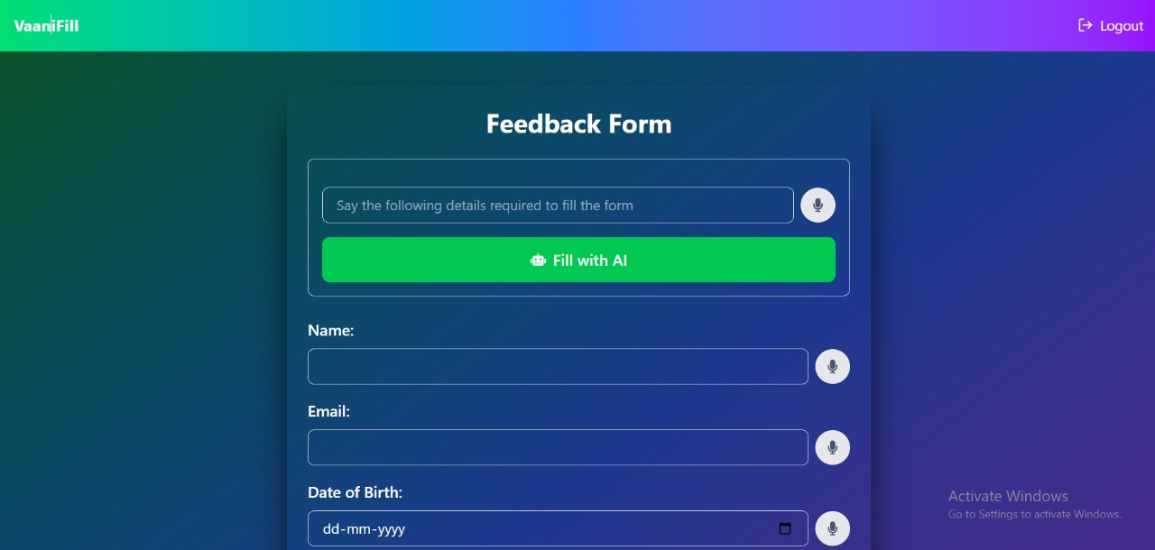
SOLUTION
✅ Voice-Enabled Form Filling – Users can speak instead of typing, making the process faster and more convenient.
✅ AI-Powered Error Correction – NLP ensures accurate text input, reducing mistakes in form entries.
✅ User-Friendly Interface – Simple and intuitive UI for easy navigation, even for non-tech users.
✅ Accessibility for All – Designed to assist elderly users and differently-abled individuals.

Slide 5

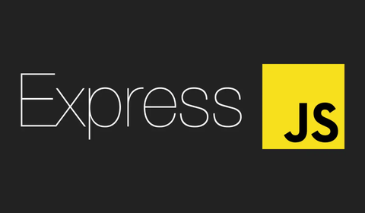

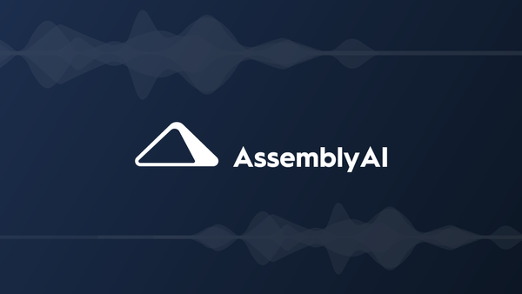
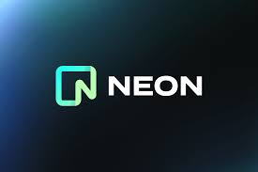
TECHNOLOGY STACK
FULL STACK
Frontend: React.js (Hosted on Vercel)
Backend: Express.js (Hosted on Render)
AI SERVICES
Gemini (For AI-driven text processing)
AssemblyAI (For speech-to-text conversion)
DATABASE
NeonDB (For storing structured data)

Slide 6
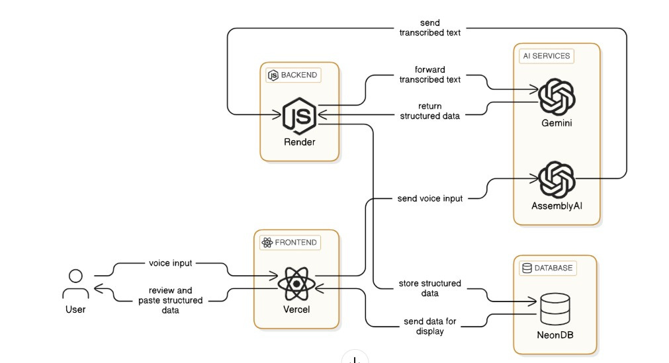
SYSTEM ARCHITECTURE

Slide 7
KEY HIGHLIGHTS
FEATURES
BENEFITS
✔️ Increased Accessibility
✔️ Higher Accuracy
✔️ User-Friendly
✔️ Boosts Productivity
✅ Multi-Language Support
✅ AI-Powered Processing
✅ Real-Time Error Detection
✅ Seamless Integration

Slide 8
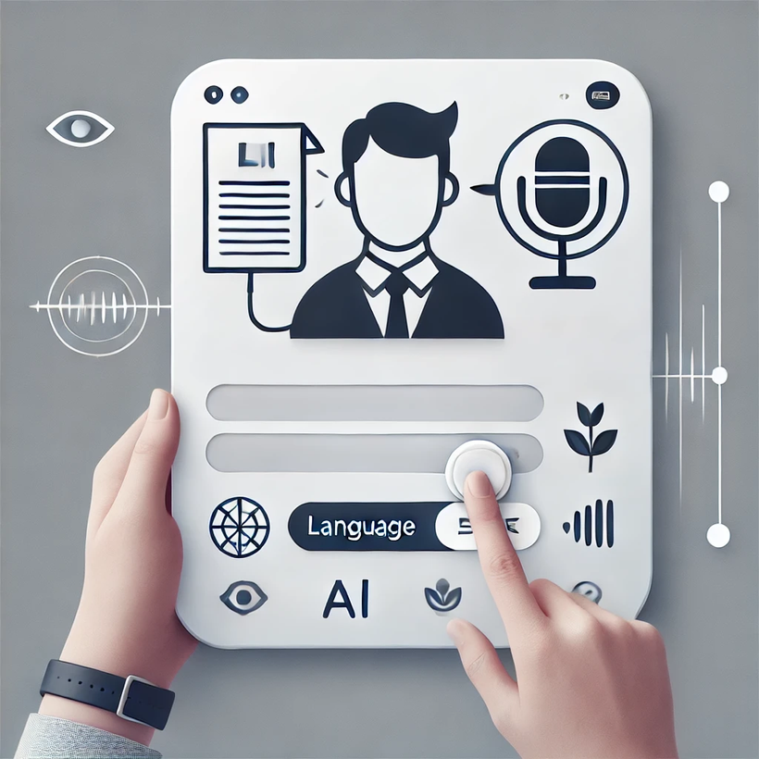
APPLICATIONS
Government Services
Healthcare
Banking & Finance
E-commerce
Education

Slide 9

DATA ANALYSIS
AI-powered voice input is rapidly expanding across industries.
High demand for accessibility & multilingual support.
The speech recognition market is growing at 15%+ CAGR.
Businesses & governments are adopting AI-driven form automation.

Slide 10
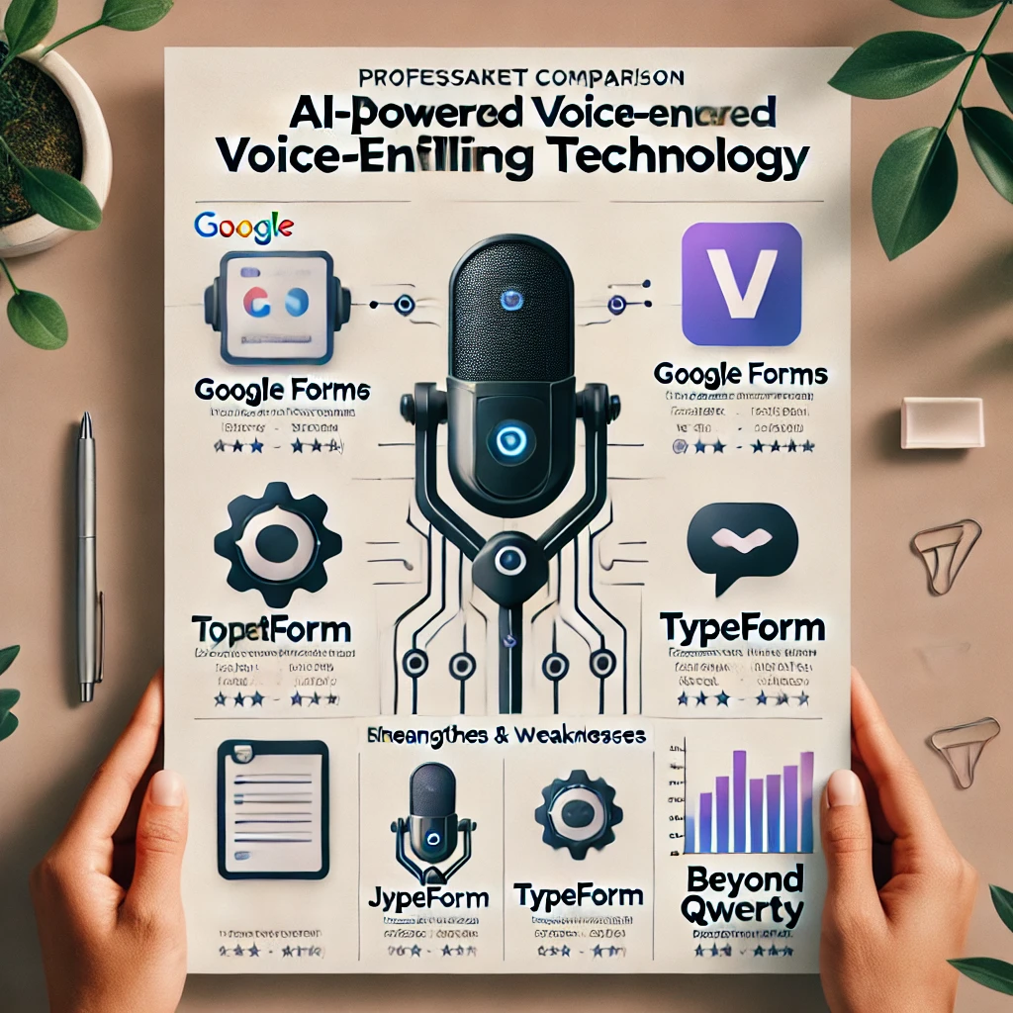
Competitive Edge
🔹 Why Beyond QWERTY?
✅ Voice-Enabled Input – No need for typing, making form-filling easier. ✅ Multi-Language Support – Overcomes language barriers for diverse users. ✅ AI-Powered Error Correction – Ensures accuracy and efficiency. ✅ Scalability & Industry Use – Can be integrated into banking, healthcare, and enterprise automation.

Slide 11
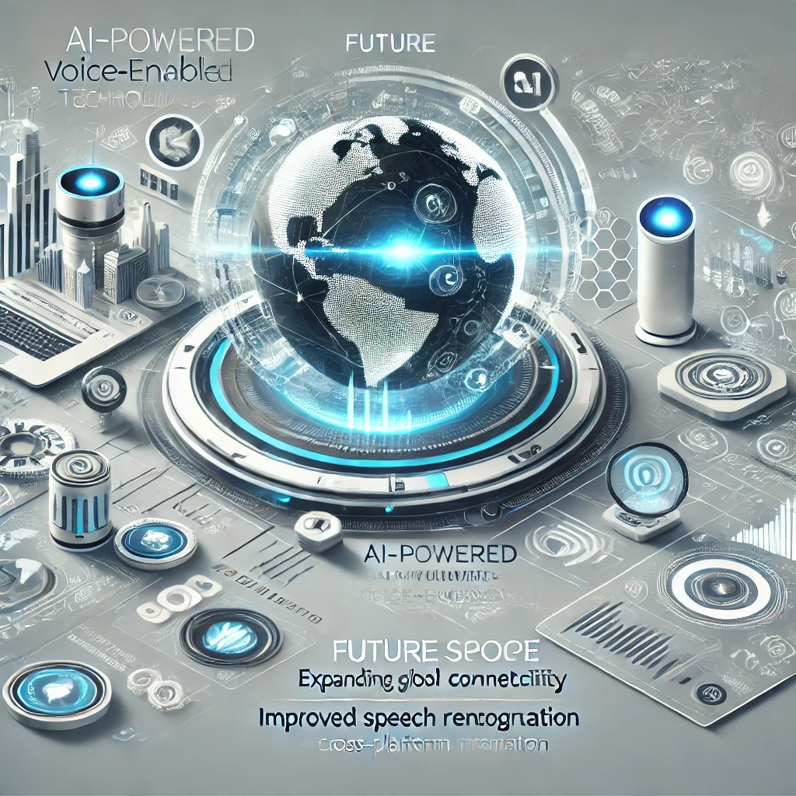
FUTURE SCOPE
🌍 Global Expansion – Support for more languages & dialects.
🧠Advanced AI–Improved speech recognition & NLP accuracy
📲Cross-Platform Integration– Mobile, web, and smart devices
🔒Enhanced Security–Stronger encryption & compliance measures.
🤖 AI Automation– Smart suggestions & predictive form-filling.

Slide 12
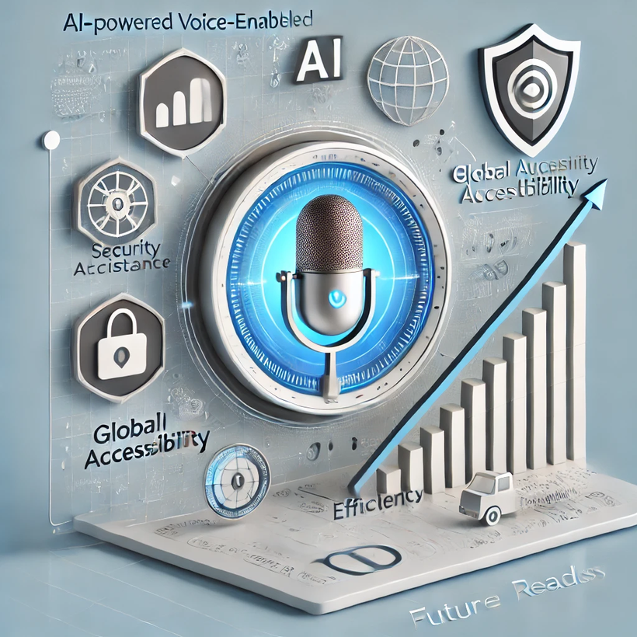
CONCLUSION
Efficient & Accessible – Voice-enabled form filling reduces manual effort, making it faster and easier for all users.
Inclusive & Scalable – Supports multiple languages and adapts to diverse user needs, enhancing digital accessibility.
Secure & Future-Ready – Ensures data privacy while leveraging AI for improved accuracy and seamless integration across platforms.

Slide 13

Next Steps
Let’s Build the Future!!!
🔹 Expanding Beyond QWERTY – Integrating more AI automation for seamless form filling. 🤝 Industry Partnerships – Seeking collaborations for large-scale adoption. 📢 Spreading Awareness – Engaging through webinars & workshops. 💡 Open-Source Growth – Encouraging contributions for continuous enhancements. 📩 Let’s Connect! – Get in touch to collaborate and shape the future together.

Slide 14
THANK YOU

